Slide 1
District Alignment Committee Working Maps and Information about alignment including upcoming Townhall Q&A

Slide 2
District 219 Realignment Committee Report

Slide 3
Committee Membership Additional Advisors
Leonard Taylor – D10
Steff Hill – D10
Allison Blakeman – D10
William McGee – D10
Stephanie Scott – D13
Carly Chiavaroli – D13
Tamika Leslie – D13
Dave Wiley – D10
Deonna Moore Taylor – D10
Kathy Wolfe – D13
Jing Humphreys – D13
Melissa McGavick – D13
Rhonda Mauer – D13
Lorie Davis – D13
Javi Diaz – D10

Slide 4
Realignment Review
Looked at the Realignment for 7, 6, 5 and 4 Divisions.
After looking at all the Division options – 6 was the general consensus choice.
Took into consideration current alignments and primarily location.
Most adjustments were renaming the Divisions/Areas
Areas are similar in size to previous alignments.
Divisions are similar in size to previous alignments.
Previous Division alignment was 7 Divisions; Alignment Committee reduced the Division number to 6.
Six Divisions Create 2 main hubs – Pittsburgh and Cleveland

Slide 5
Realignment Guidelines Followed
Six Divisions in Realignment.
Divisions labelled left(West) to right(East) on the map A thru E
Each Division must have at least 4 areas(per Toastmaster Guidelines).
Each Area must have 4-6 Clubs(per Toastmaster Guidelines).
Division A – Areas Begin with 10 thru 19 if needed
Division B – Areas Begin with 20 thru 29 if needed
Division C – Areas Begin with 30 thru 39 if needed
Division D – Areas Begin with 40 thru 49 if needed
Division E – Areas Being with 50 thru 59 if needed
Division F – Areas Begin with 60 thru 69 if needed
X – Will be removed for Final. Anticipated Suspended Clubs.

Slide 6
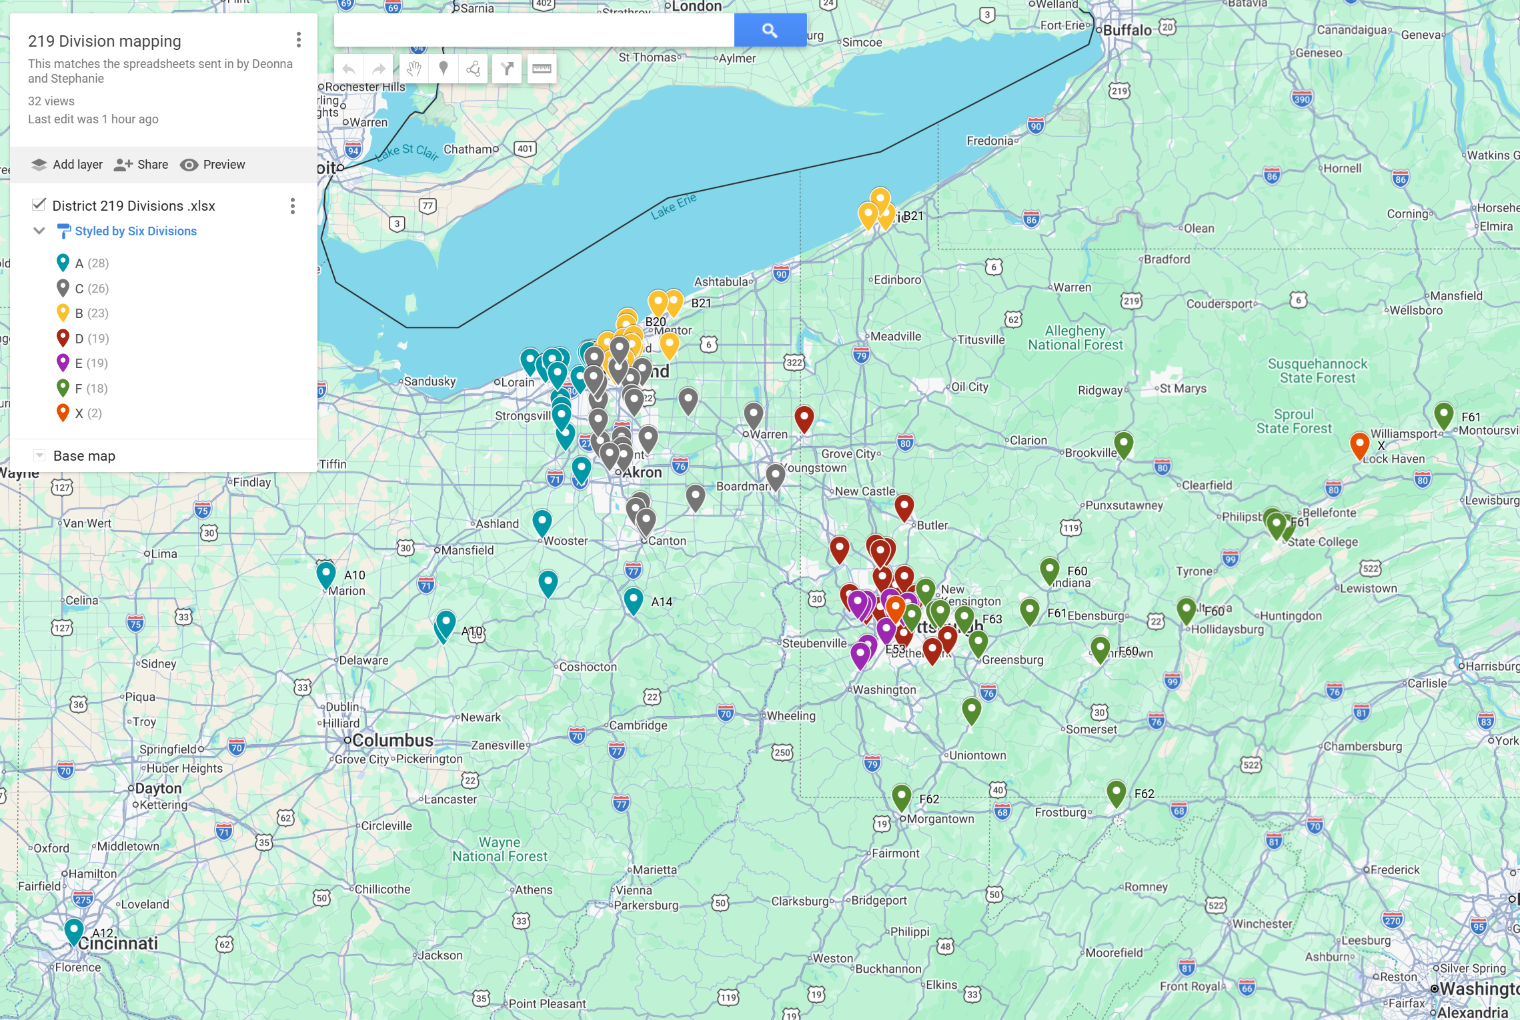
Six Divisions
https://www.google.com/maps/d/edit?mid=1d5MjKaMATCNwMtxML-ksDYRDFt15tjs&usp=sharing
For a more Interactive View use Link above to Current Division Map

Slide 7
Area Breakout 27 Areas Total
https://www.google.com/maps/d/edit?mid=1xdJzntRUC5z-HPGGi0f45mqam_qjZHU&usp=sharing
For a more interactive view –Use Link Above to Current Area Map
Div A – 5 Areas
Div B – 5 Areas
Div C – 5 Areas
Div D – 4 Areas
Div E – 4 Areas
Div F – 4 Areas

Slide 8
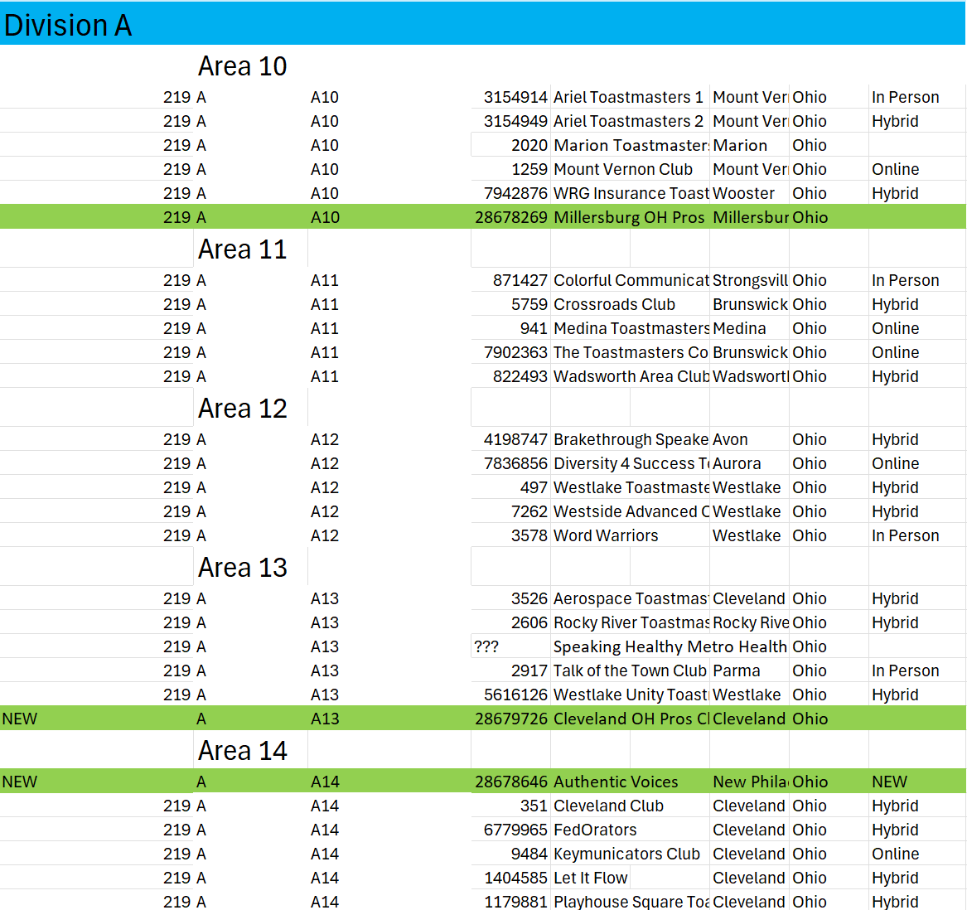
Division A

Slide 9
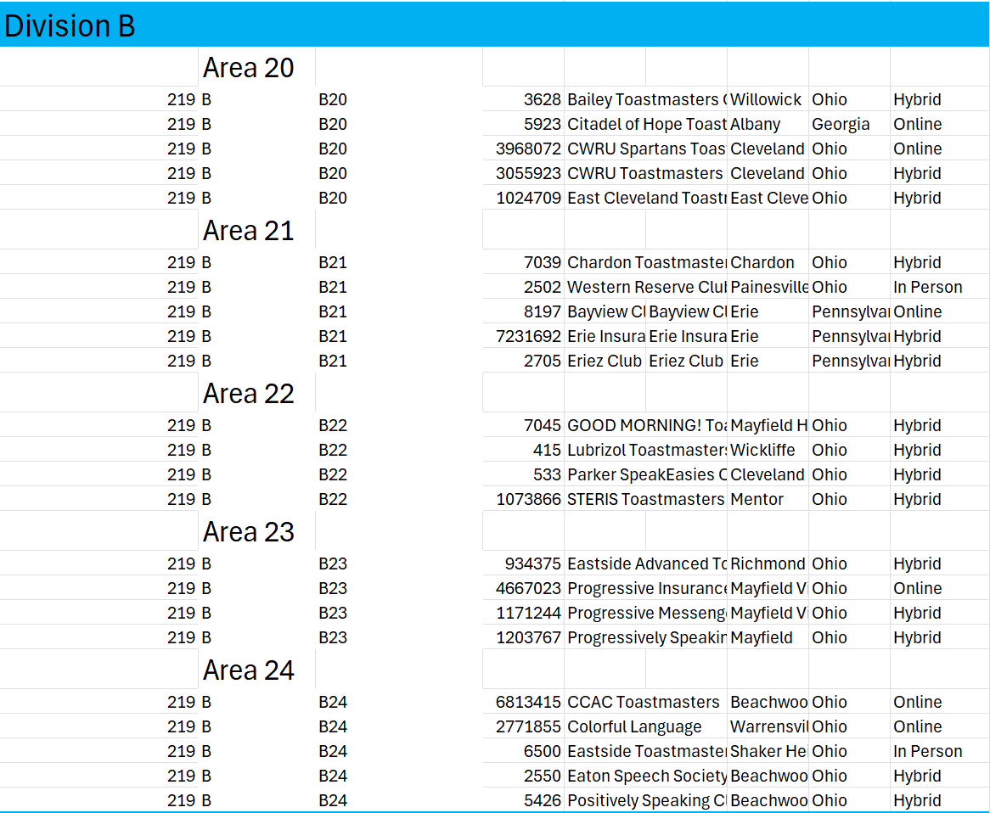
Division B

Slide 10
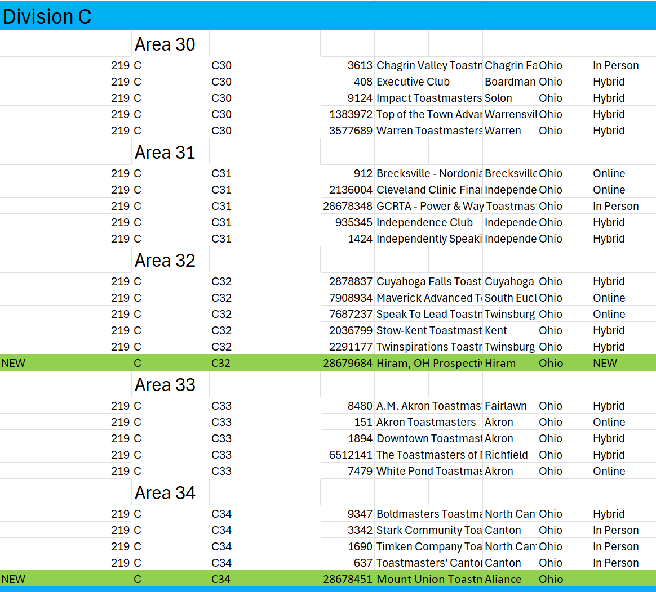
Division C

Slide 11
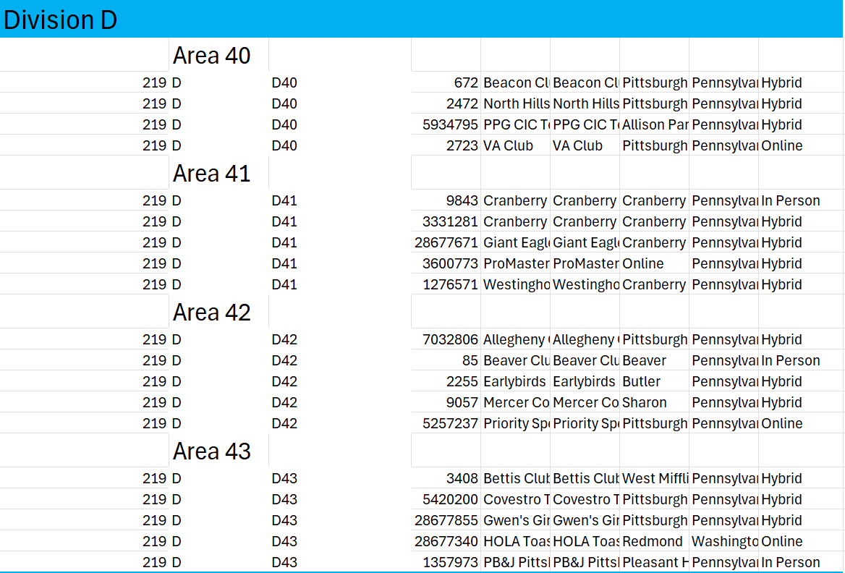
Division D

Slide 12
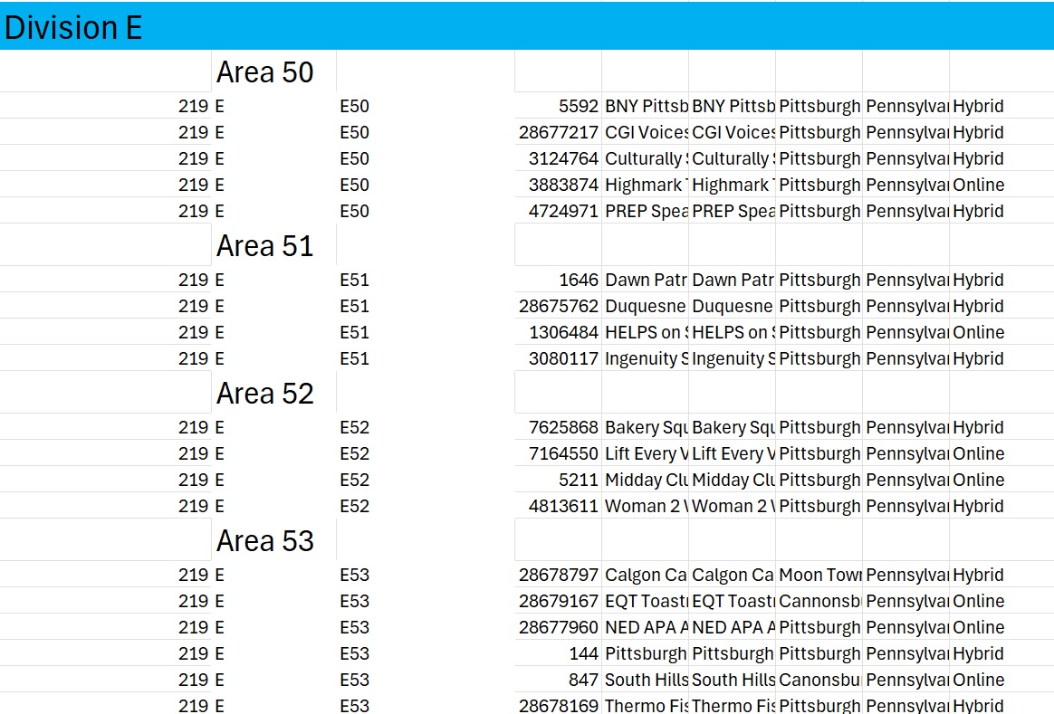
Division E

Slide 13
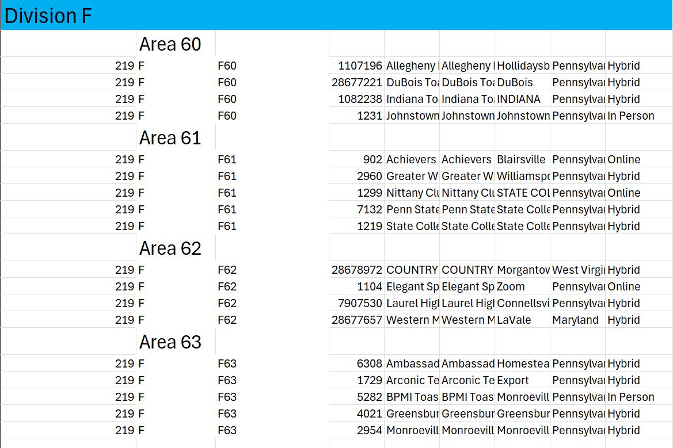
Division F

Slide 14
District 219 Realignment
Questions on Alignment????
Town Hall Q&A
March 12, 8:00 PM – 9:00 PM
https://us02web.zoom.us/j/84094774161

